Slide 1
Test driven development in mendix
Ted Bracht
ted@tedbracht.co.uk

Slide 2
About ted bracht
2 ½ years Mendix consultancy
Legal, Insurance, Pharmaceutical, Accounting, Government
30+ years Project Management, Product Architecture, Scrum Master, Change Management
Partner with Bizzomate – Avola – Decision Modeling
Early adopter of eXtreme Programming, Agile, Scrum

Slide 3
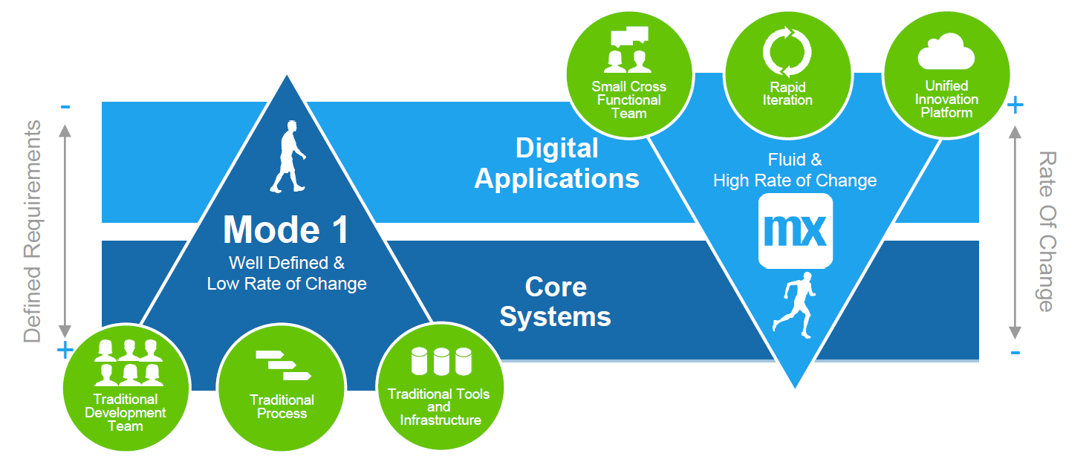
Mendix - Mode 2 – agile - high rate of change
Rapid Application Development
So rapid, that testers can’t keep up!
Support for Refactoring; rename, restructure etc
Regression testing!

Slide 4
Testing from developer’s pov
Does what I just built do what I expect it to do?
Am I sure that I haven’t broken anything?

Slide 5
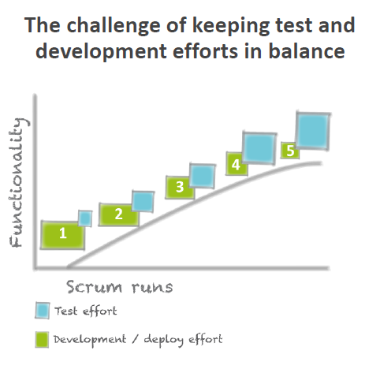
From the mansystems ats webinar

Slide 6
Testing automation
Selenium – UI focus
Mansystems ATS – End-to-End
Unit Testing (Mendix App store module)

Slide 7
Unit testing
What is a Unit?
A function that can be tested in isolation
A unit test has one of three results;
Success – all good
Fail – the result is different from the expected result
Error – the test could not be run – runtime error
Example Roman Numerals: As a User I want to retrieve the numeric value of a Roman Numeral letter, for example “I” = 1, “V” = 5, “X” = 10.
Unit test: assert that the function returns 10 when I provide a “X”

Slide 8
Test Driven Development (1)
Start with writing the test;
Test that when the input parameter is “X”, the result is 10
The test defines the signature (input parameters and result type) of the function
Then write the Microflow to be tested (the function);
Input parameter a letter
Result an integer
Naming: returnValueOfRomanNumeralLetter – intention revealing

Slide 9
Test driven development (2)
Write the simplest code that makes the test pass
In ‘Pure TDD’:
Write the MF with just the signature
Compile, run – fail – expected 10, return 0
Amend the MF to return 10 (hardcoded)
Compile, run – success
Add test with different input, for example “V”
Compile, run – fail – expected 5, return 10
Amend the MF to return 5 for “V”, 10 for “X”
Compile, run – success
Add test etc
Demo

Slide 10
Regression Testing
All tests are run every time
Whenever new tests are added, compile and run the whole test set
Never commit to the server when tests are still failing
A story is not finished until it has a comprehensive testset that runs successfully
A story is not finished until all existing tests run successfully as well

Slide 11
Focus on functions
Unit Tests = Tests of individual Functions
Separate UI interactions and DB interactions from functions

Slide 12
Typical Mendix microflow
Retrieve data
Manipulate
Write back / commit
‘Mock objects’
Unit test

Slide 13
Functional programming
Focus on ‘pure’ functions
Functions without side effects
Call a function with a set input should always give the same results
No state change within the function
Referential transparency

Slide 14
Speed of development
Thinking slows you down …
Think of a test …
Think of proper naming of a function …
Separate functions from retrieves and commits
Run tests every time you compile and debug until success

Slide 15
Speed vs quality
The first 3 months into development your velocity with TDD will be lower than without TDD
After 3 months the existing code base will start requiring refactoring – that is where TDD starts to catch up
New functionality integrate with existing
New insights / user feedback
Acceptance tests
How many projects are done and finished within 3 months and never touched again?

Slide 16
Questions?
https://github.com/flyingdutch20/Mendix-TDD
ted@tedbracht.co.uk

